Slide 1

Namma Yatri

Slide 2
Problem Statement
To provide actionable insights to the management of Namma Yatri focusing on improving:
The Ride industry facing challenges like trip cancellations, demand supply mismatches, fare fluctuations. This analysis aims to develop Power BI dashboard to optimize operations and enhance customer experience.
Objectives
Analyze ride patterns to identify key patterns
Optimize fare pricing pattern using data insights.
Improving driver allocation based on demand supply trends.

Slide 3
Approach & Tools Used
Data cleaning & transformation in Power Query.
Data Modelling & creating relationship between the tables in Power BI desktop.
Dax calculations for important KPI’s
Dashboard creating & Insights Extractions.
Business Recommendations & implementations.

Slide 4
Data Source
Trips table with the following variables (Trip ID, Fare, Duration, Distance, Driver ID, Customer ID).
Trip Details table with the following variables(Customer interactions, Cancellations, Completions).
Payment Methods table with the following variables (Cash, UPI, Debit Card).
Assembly table with the following variables (Pickup & Drop Zones).

Slide 5
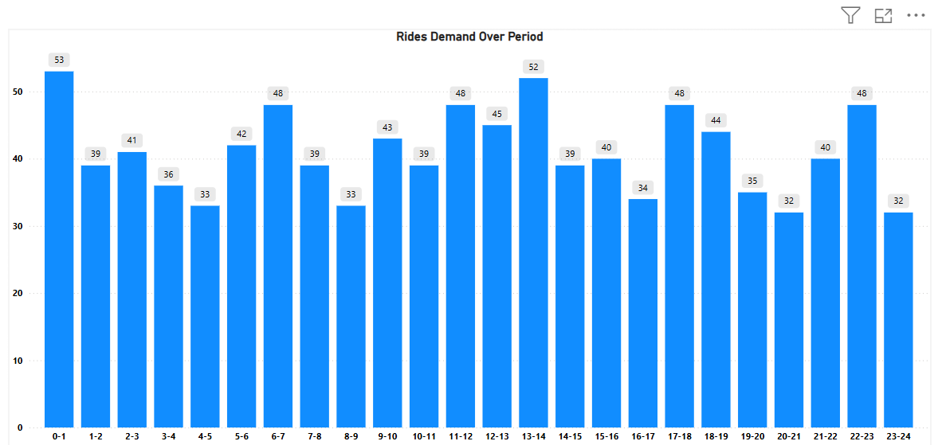
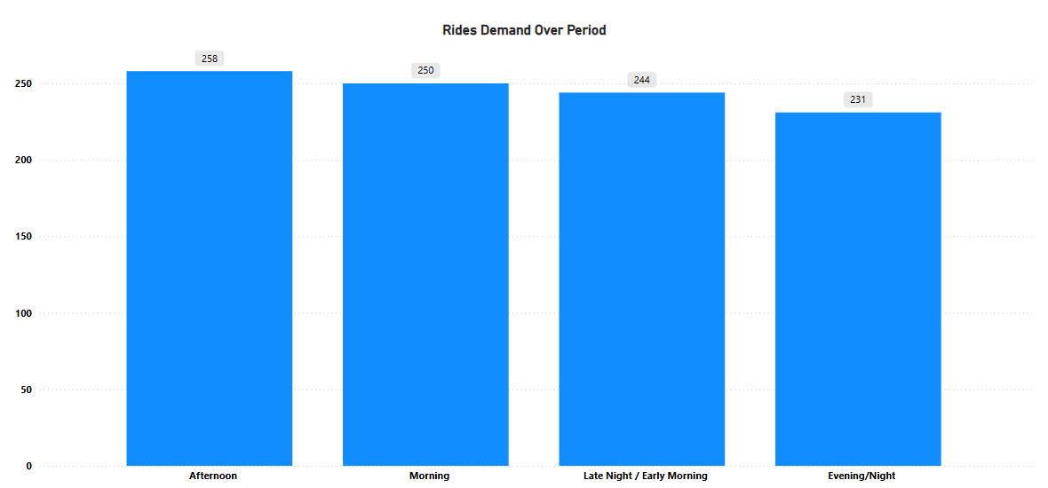
Insights Generated from the Data
Analysing the distribution of ride demand over the period of time.
Identified peak hours of like 0-1, 13-14, 6-7 are highest peak hours where customers has more demand for rides.
While compared with Early Morning, Morning, Afternoon, Evening.
Observed Afternoon has the more demand from of ride leading with 258 completed rides.

Slide 6
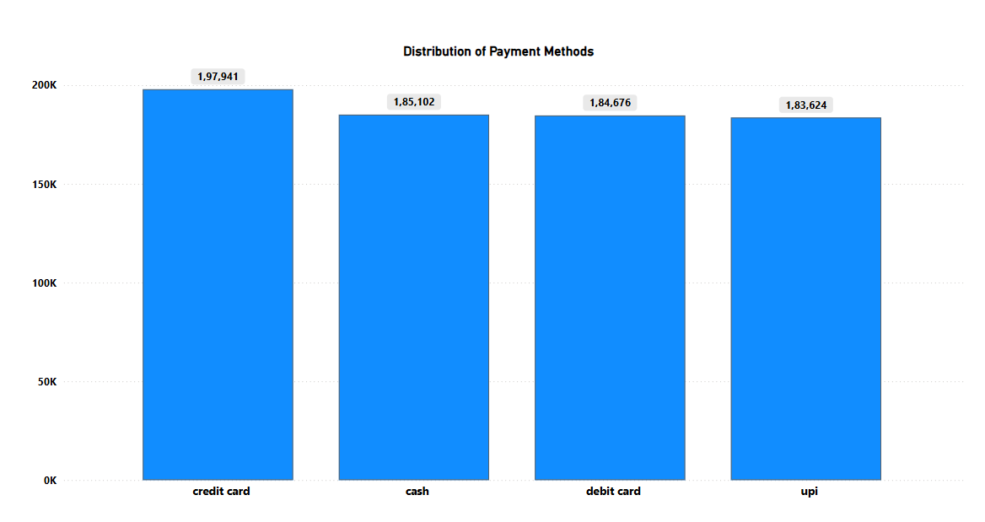
Payment Methods
Most Preferred Method: Credit Card
Credit card leads in total fare amount collected.
Indicates a high adoption of credit card-based payments, possible by frequent riders.
Suggests strong trust in digital security and app integration.
Very close Competition
The difference between cash, debit card, and UPI is relatively minimal (1-2k difference).
Implies a balanced adoption of various payment methods.
This diversity may reflect user preference, availability, or app offers. Cash Still Prominent
Despite digital transactions are high, cash remains the second most used.
Might be common among:
Area with Poor internet connectivity.
Spontaneous trip users.

Slide 7
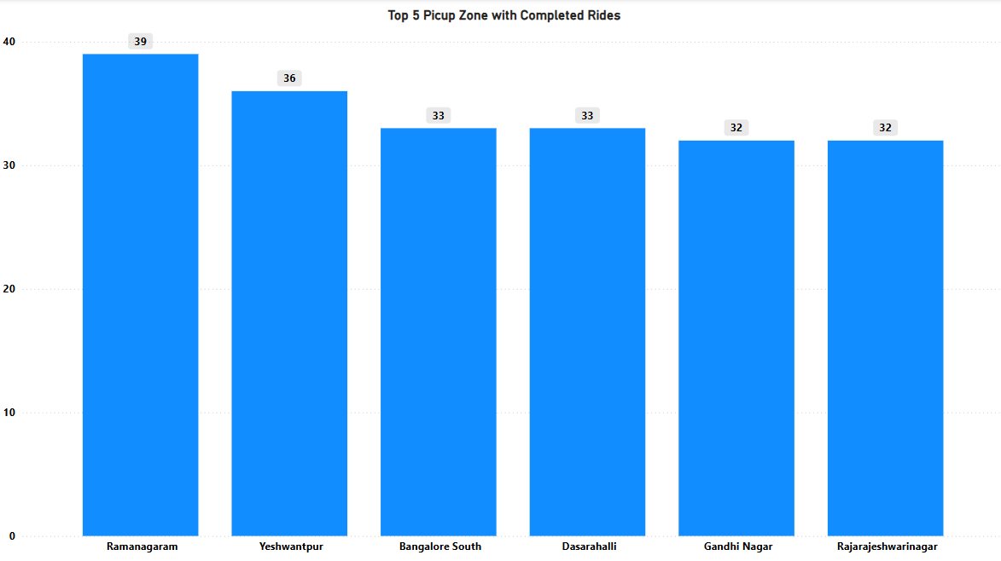
Top Zones with highest trip volume
Ramanagaram, Yeshwanthpur, Bangalore South, Dasarahalli, Gandhi Nagar are the top 5 pickup zones with highest number of completed trips.
Below might be the factors of contributing highest number of completed trips.
Possibility of a commuter hub or connecting point for long distance travelers.
Major transportation hub with busy railway station or metro connectivity.
Large residential and commercial mix, which fuels demand throughout the day.

Slide 8
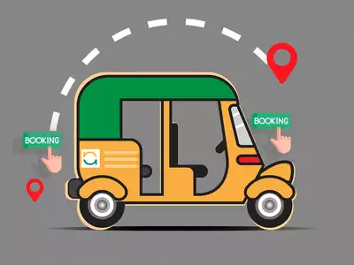
Business Insights
High drop off rates during fare estimates – Implementing predective pricing model.
Demand supply gaps in key locations – Increasing drivers allocation in hight demand locations.
Fare spikes during peak hours – Optimizing dynamic fare pricing for all the rides.
Digital payements are higher but still cash payments almost equal – Providing offers for digital payment incentives.

Slide 9
Improvements Required
Increasing demand supply matching to reduce ride confirmation wait time.
Fare obtimization to balance affordability of rides and increase revenue.
Improving performance of the drivers through better allocation of location.
Increating digital payments through targeted incentives.

Slide 10
Conclusion
Data driven insights helps optimize rides operations.
Giving best offers to the regular customers to reduce cancellation from regular customers and boost customer retentions.
Smart allocation of the drives at the main locations to improve the efficiency and service quality.
Giving incentives to the drives who allocated at the peak hours to reduce the drivers cancellation.

